Slide 1
Routing and Routers

Slide 2
Routing and Routers
Router Basics
Router Startup procedure
Routing
Router configuration

Slide 3

Router Basics

Slide 4
Internal Components
RAM
NVRAM
Flash
ROM
Console
Interfaces
Auxiliary

Slide 5
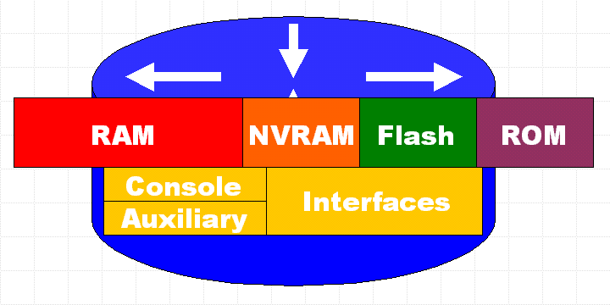
RAM
Temporary storage for router configuration files
RAM content is lost on power down or restart
Stores...
Routing tables
ARP cache
Fast switching cache
Packet buffering
Packet hold queues
Notes:
运行操作系统:
运行配置文件: running-config
IP 路由表:
ARP 缓存:
数据包缓存区:到达接口之后以及送出接口之前

Slide 6
NVRAM
Non-volatile RAM
Stores backup/startup configuration files
Content is not lost when router is powered down or restarted.
Notes:
存储启动配置. 这包括IP地址，路由协议，主机名
Startup-config

Slide 7
Flash
EEPROM (Electronically Erasable Programmable Read-Only Memory)
Holds the Cisco IOS (Internet Operating System)
Allows updating of software without replacing the Flash chip
Multiple versions of IOS can be stored
Retained on power down

Slide 8
ROM
Contains POST (Power On Self Test)
A bootstrap program (loads the Cisco IOS)
And operating system software
Backup, trimmed down version of the IOS
Upgrades require installing new chip set
Notes:
保存开机自检软件，存储路由器的启动引导程序
bootstrap 指令
基本的自检软件
迷你版 IOS.

Slide 9
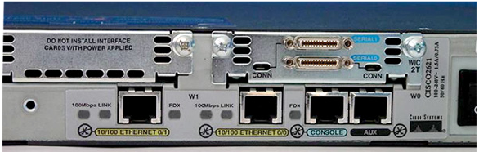
Interfaces
Network connections through which packets enter and exit the router
Attached to the motherboard or as separate modules.
Notes:
拥有多种物理接口用于连接网络.
Console 口、Auxiliary 口
-以太网
-快速以太网
-串口
-DSL
-ISDN
-Cable

Slide 10
Router Startup Procedure

Slide 11
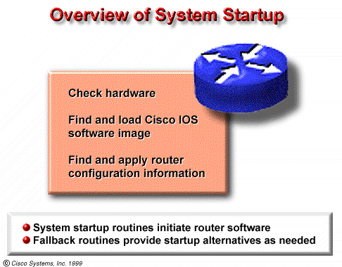
System Startup Procedure
1. Perform a power-up self test(POST):During this self test, the router executes diagnostics from ROM on all hardware modules.
2. Verify the basic operation of CPU, memory, and network interface ports.
3. Software initialization.
Notes:
检测路由器硬件
Power-On Self Test (POST)
执行引导装入程序
定位加载 Cisco IOS 软件
-定位 IOS
-加载 IOS
定位加载启动配置文件或进入配置模式
-启动程序搜寻配置文件

Slide 12
Software Startup Procedure
Step 1 - The generic bootstrap loader, in ROM, executes on the CPU card.
Step 2 - The operating system (Cisco IOS) can be found in one of several places. The location is disclosed in the boot field of the configuration register.
Step 3 - The operating system image is loaded.
Step 4 - The configuration file saved in NVRAM is loaded into main memory and executed one line at a time.
Step 5 - If no valid configuration file in NVRAM, then executes a question-driven initial configuration routine referred to as the system configuration dialog, also called the setup mode.
Notes:
路由器启动的主要步骤
检测路由器硬件，Power-On Self Test (POST)
执行引导装入程序，定位加载 Cisco IOS 软件
-定位 IOS
-加载 IOS
定位加载启动配置文件或进入配置模式
-启动程序搜寻配置文件

Slide 13
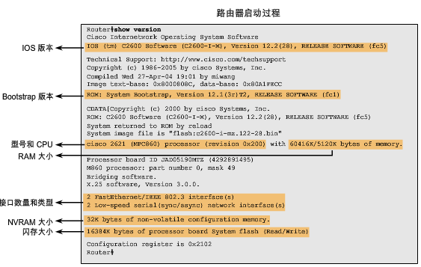
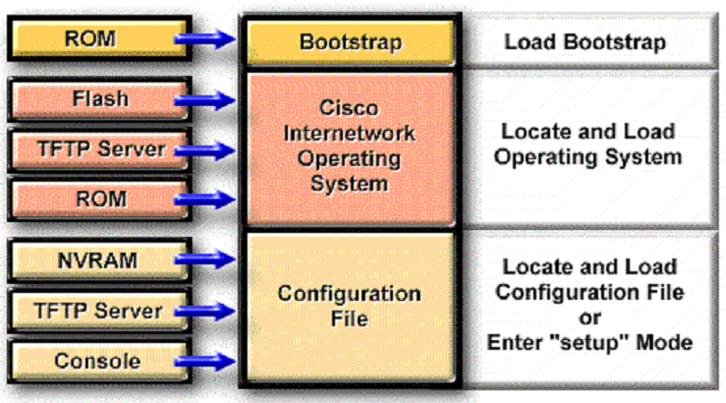
Router Startup Procedure
Setup is not intended as the mode for entering complex protocol features in the router.
You should use setup to bring up a minimal configuration, then use various configuration-mode commands, rather than setup, for most router configuration tasks

Slide 14
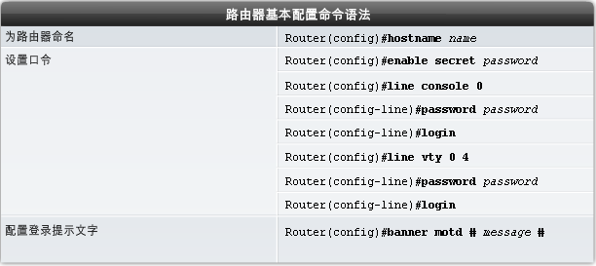
基本的路由器配置
Notes:
子接口命令，line vty 0 4 是最大允许5个人同时telnet Router登陆
路由器可以有多种登陆方式，比如telnet和console，最简单的就是console通过一个console线，一端查到路由器上，一端连到电脑上，就可以对路由器进行配置了。 line console 0 可以设置控制台的一些状态，比如在line console 0可以设置exec-timeout和logging synchronous，前者可以设置不输入命令多长时间系统弹出，而后一个命令则可以设置在输入命令时不会被系统日志消息打断。而在console里加密是为了防止有其他非授权用户通过console口访问路由器或者交换机 一台路由器只有一个console接口，而且路由器上的接口一般是从0开始的，所以只能是0

Slide 15
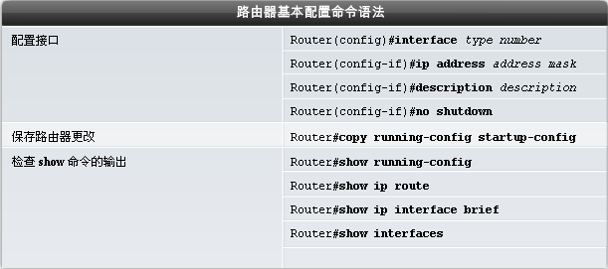
执行基本的编址方案

Slide 16
检验基本的路由配置
-使用 show running-config 命令
-存储路由器基本配置 copy running-config startup-config
-其他检验路由器的命令:
Show running-config – 显示当前随机访问存储器中的配置
Show startup-config – 显示NVRAM中的配置文件
Show IP route – 现实路由表
Show interfaces – 显示所有接口的配置信息
Show IP int brief -显示接口的简要信息

Slide 17
Routing

Slide 18
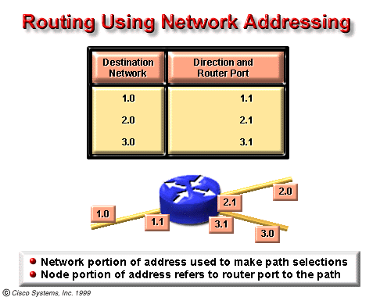
A router generally relays a packet from one data link to another, using two basic functions, a path determination function and a switching function.
The switching function allows a router to accept a packet on one interface and forward it through a second interface.
The path determination function enables the router to select the most appropriate interface for forwarding a packet.
The router uses the network portion of the address to make path selections to pass the packet to the next router
The node portion of the address is used by the the router directly connected to the destination network to deliver the packet to the correct host.

Slide 19
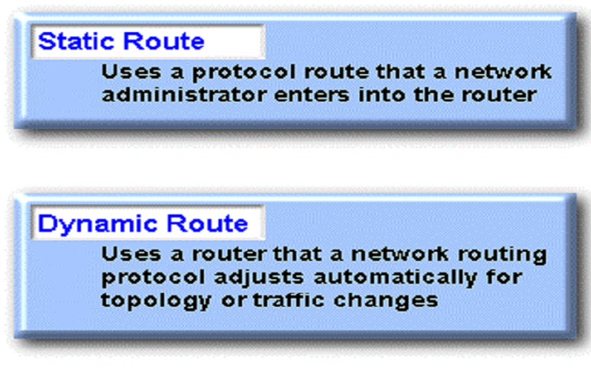
Static and Dynamic Route

Slide 20
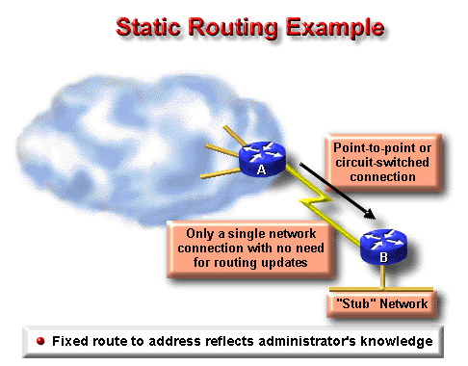
Static and Dynamic Route
Whereas dynamic routing tends to reveal everything known about an internetwork, for security reasons, you may want to hide parts of an internetwork.
When a network is accessible by only one path, a static route to the network can be sufficient.
This type of partition is called a stub network.

Slide 21
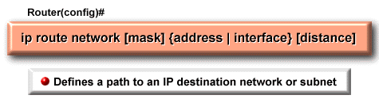
Static Route Configuration
A static route allows manual configuration of the routing table.
ip route Command
Description
network
destination network or subnet
mask
subnet mask
address
IP address of the next-hop router
interface
the interface to use to get to the destination network
distance
administrative distance

Slide 22
Administrative Distance
The administrative distance is a rating of the trustworthiness of a routing information source, expressed as a numeric value from 0 to 255.
The higher the number, the lower the trustworthiness rating.
So the administrative distance of static routes is often low.(1 is the default)

Slide 23
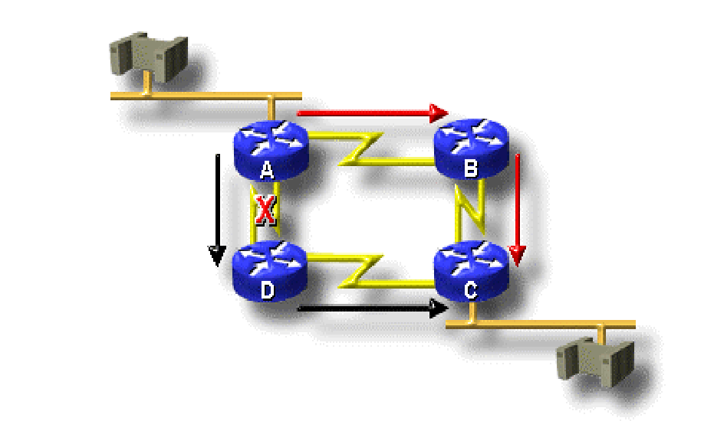
Dynamic Routing
Dynamic routing protocols can also redirect traffic (or loadshare) between different paths in a network
.

Slide 24
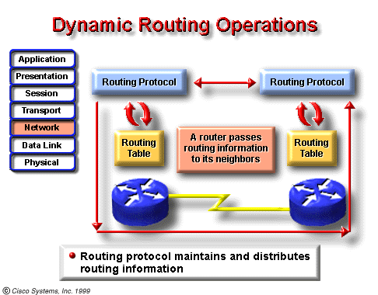
Dynamic routing
Dynamic routing relies on a routing protocol to share knowledge among routers.
The dynamic routing depends on two basic router functions:
maintenance of a routing table
distribution of knowledge to other routers

Slide 25
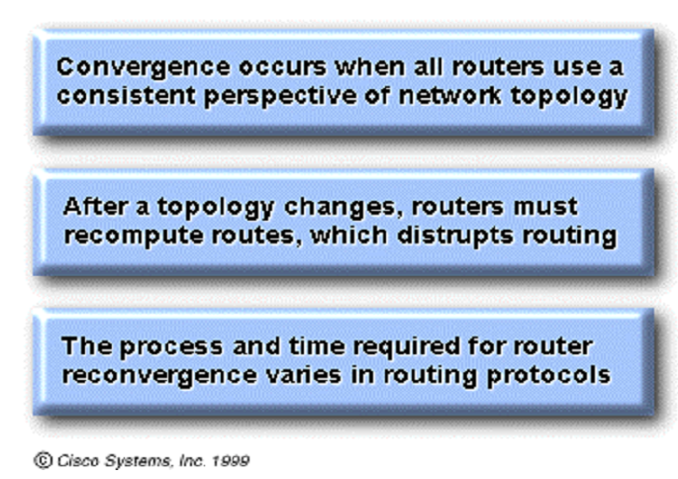
Time to Convergence

Slide 26
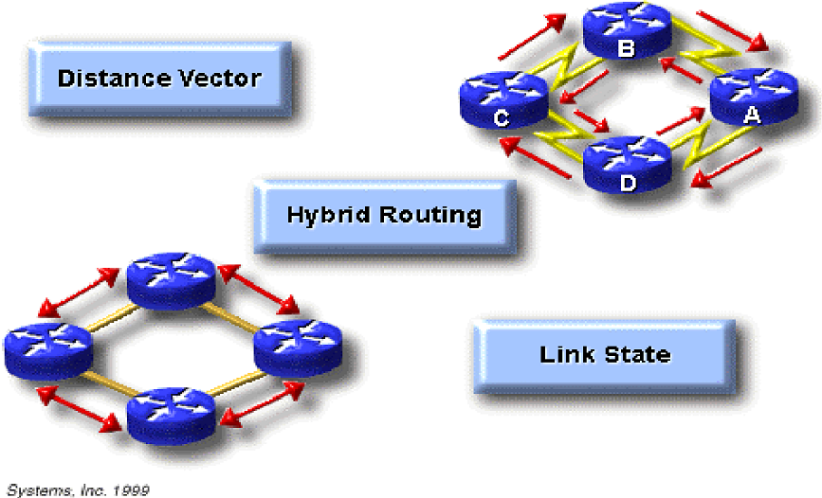
Classification of Routing Protocols

Slide 27
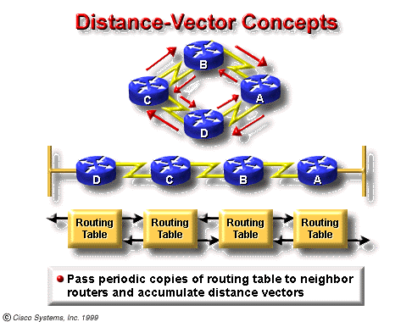
Distance-Vector Protocol
Distance-vector algorithms do not allow a router to know the exact topology of an internetwork
Distance-vector-based routing algorithms (also known as Bellman-Ford algorithms) pass periodic copies of a routing table from router to router.

Slide 28
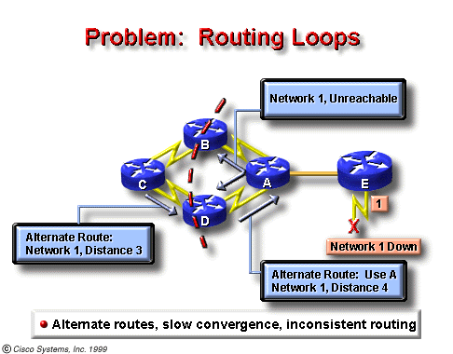

Slide 29
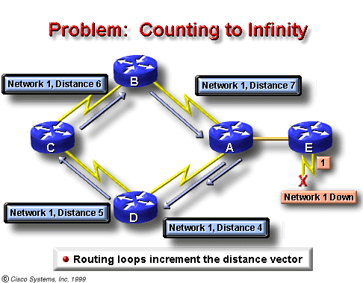
The invalid updates of Network 1 will continue to loop until some other process stops the looping.
This condition, called count to infinity, loops packets continuously around the network in spite of the fundamental fact that the destination network, Network 1, is down.
While the routers are counting to infinity, the invalid information allows a routing loop to exist.

Slide 30
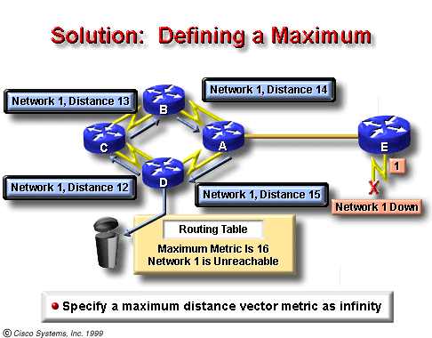
Solution: Defining a Maximum

Slide 31
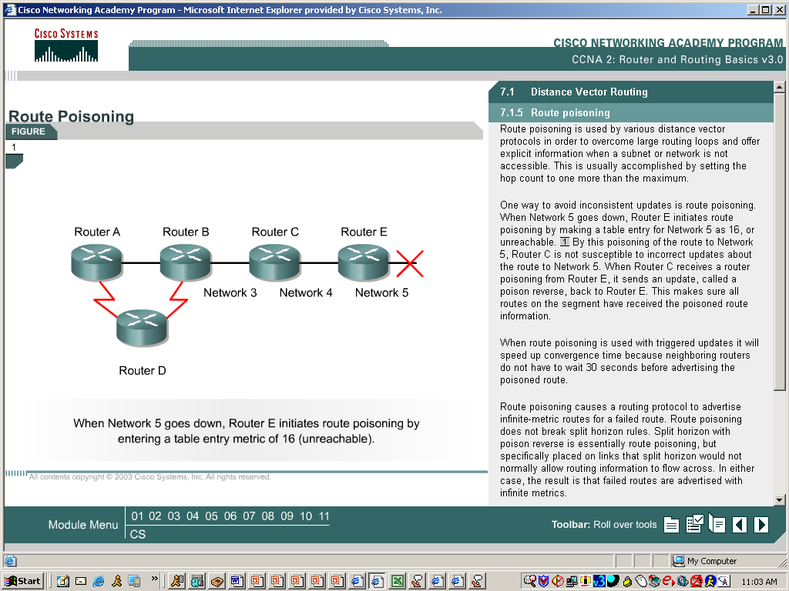
Solution: Route Poisoning
When Network 5 goes down, Router E initiates route poisoning by making a table entry for Network 5 as 16, or unreachable.
When Router C receives a route poisoning from Router E, it sends an update, called a poison reverse, back to Router E. This makes sure all routers on the segment have received the poisoned route information.
Notes:
Poison reverse, 其中一种防止路由回圈(Routing loop)出现的技术, Distance Vector routing protocol的运作特性是定期向外发送routing table而让网络中其他router知道其网络, 例如Router A使用RIP作为routing protocol, 预设每30秒做一次routing update, 把其routing table向外广播, 而邻接A的Router B, 正常每30秒会收到从A发送过来的update。设想若A连接的其中一个网络(假设网络X)中断, 网络X会消失於A中的routing table, 当Router A下次发送往外更新资料时, 会不包括X在内, 而Router B因为没有收到关於Network X的更新, 在一定时间内(RIP预设Invalid time为180秒)会误认为Network X还存在, 并向外告知X的存在, 直至经过180秒後, Router B才认为Network X出现问题, 在这180秒内整个网络处於一个不正确资料状态, 除Router A外, 其他路由器都不清楚Network X的问题, 会形成很多传输错误的发生, 亦会因此引起Routing loop的产生。Poison Reverse的理念是当Router A发现Network X的中断後, 在下次做routing update时不会忽略X, 反而会把X包含到routing update当中, 但将其跳跃数Hop count变更为Maximum+1(RIP为15+1), 因为Hop count超过了Maximum, 所以Router B收到更新时会立刻知道Network X为Inaccessible, 而无需等待180秒, 这样便会大大地加快网络收敛的速度。Poison Reverse理念大致如此

Slide 32
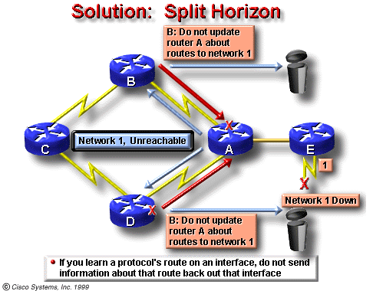
Solution: Split Horizon
Notes:
路由器从某个接口接收到的更新信息不允许再从这个接口发回去。
1，能够阻止路由环路的产生。
2，减少路由器更新信息占用的链路带宽资源。
毒性逆转（Poisoned Reverse）实际上是一种改进的水平分割，这种方法的运作原理是：路由器从某个接口上接收到某个网段的路由信息之后，并不是不往回发送信息了，而是发送，只不过是将这个网段的跳数设为无限大，再发送出去。收到此种的路由信息后，接收方路由器会立刻抛弃该路由，而不是等待其老化时间到（Age Out）。这样可以加速路由的收敛。

Slide 33
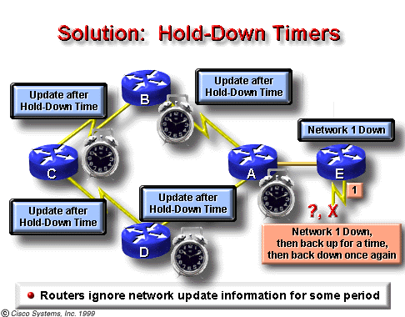
Solution: Hold-Down Timers
Notes:
挂起计数器（Hold-Down Timers） 所谓挂起计数器是指路由器需要将某些可能导致路由环路的网络状态的变化保留一段时间，在这段时间内，路由器将视情况对这些网络状态的变化所产生的路由信息进行更改。下面看一下挂起计数器是如何工作的：
当一个路由器从它的邻居那儿收到以前某个可访问的网络现
在变为不可访问的信息时，路由器将指向该网络的路由设置为不可访问，同时启动计数器。
如果在计数器到期前，该路由器又从同一个邻居那儿收到该网络可以访问的信息，则它会重新将网络标记为可访问，并删除计数器。
如果该路由器从另外一个邻居那儿收到一条比原路由更好的访问该网络的路由信息，它同样将该网络标记为可访问，以新的路由替代原路由，并删除计数器。
如果在计数器到期前，该路由器从另外一个邻居那儿收到一条访问该网络的比原路由差的路由信息，这条信息将被忽略。这样做能够使“网络不可访问”的信息有更多的时间在整个网络上传播。
计数器到期后，该路由标记为不可到达，如果这时收到该网络可以访问的路由信息，路由器的处理方式同上。
计数器计数时间的长短应该略大于路由信息传遍整个网络所需的时间。

Slide 34
Prevent Sending Route update
To prevent an interface from sending out any route update information,use the command:
Router(config-router)#Passive-interface f0/0
It is valid only when using distance-vector routing protocols, because link-state routing protocols do not get the topology information directly from the routing table of its neighbors
Notes:
被动接口。。。。。。看你是用的是什么路由协议，不同的路由协议具有不同的效果，RIP和IGRP是不发送路由更新，但接受路由更新，OSF和EIGRP不接受也不发送路由协议

Slide 35
Link-state Protocol
Link-state based routing algorithms also known as SPF (shortest path first) algorithms, maintain a complex database of topology information.
Link-state routing uses:
link-state advertisements(LSAs)
a topological database
the SPF algorithm, and the resulting SPF tree
a routing table of paths and ports to each network
RFC 1583 contains a description of OSPF link-state concepts and operations.

Slide 36
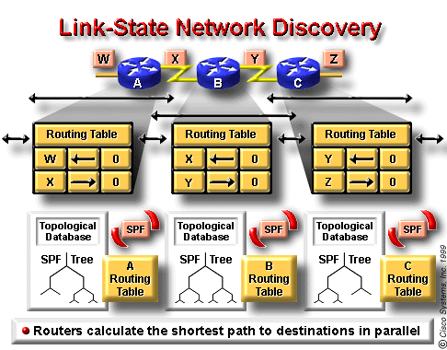
Routers exchange LSAs with each other. Each router begins with directly connected networks
Each router in parallel with the others constructs a topological database consisting of all the LSAs from the internetwork.
The SPF algorithm computes network reachability. The router constructs this logical topology as a tree, with itself as root, consisting of all possible paths to each network in the link-state protocol internetwork. It then sorts these paths shortest path first (SPF).
4. The router lists its best paths, and the ports to these destination networks, in the routing table. It also maintains other databases of topology elements and status details.
Notes:
怎么做负载均衡？

Slide 37
Link-state Concerns
There are two link-state concerns:
Processing and memory requirements
Running link-state routing protocols in most situations requires that routers use more memory and perform more processing than distance-vector routing protocols.
Bandwidth requirements
During Initial link-state packet flooding, all routers using link-state routing protocols send LSA packets to all other routers. This action floods the internetwork as routers make their demand for bandwidth, and temporarily reduce the bandwidth available for routed traffic that carries user data.

Slide 38
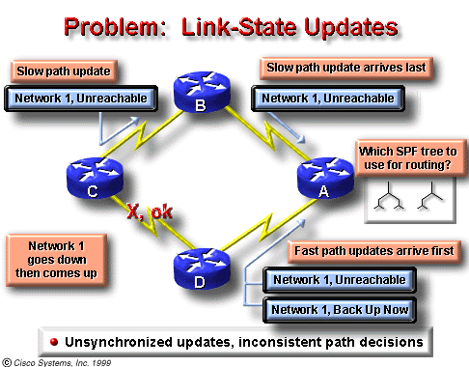
Problem: Link-state Updates
Link-state routing must make sure that all routers get all necessary LSA packets.
Routers with different sets of LSAs calculate routes based on different topological data.

Slide 39
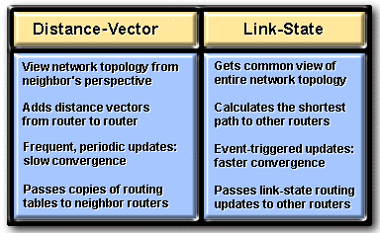
Comparing: Link-state and Distance-Vector

Slide 40
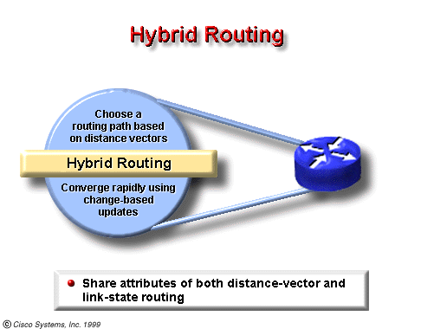
Hybrid Protocols
Examples of hybrid protocols:
OSI’s IS-IS (Intermediate System-to-Intermediate System)
Cisco’s EIGRP (Enhanced Interior Gateway Routing Protocol ).

Slide 41
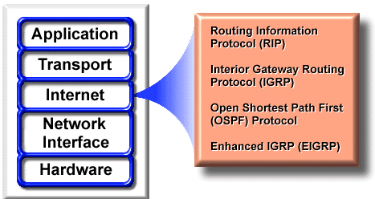
Routing Protocols
Examples of IP routing protocols include:
RIP - a distance-vector routing protocol
IGRP - Cisco’s distance-vector routing protocol
OSPF - a link-state routing protocol
EIGRP - a balanced hybrid routing protocol

Slide 42
Primary Goals of Routing Protocols
Optimal Route—pick the best route
Efficiency—minimal use of bandwidth and router processor resources
Rapid Convergence—the faster, the better. Some are quicker at converging than others.
Flexibility—can handle a wide variety of situations such as high usage and failed routes

Slide 43
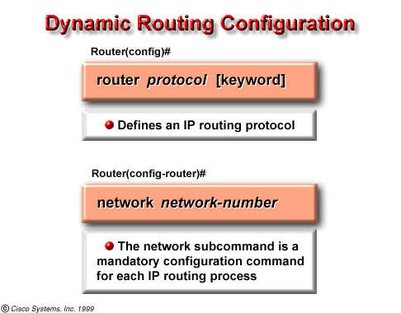
Router Commands
Description
protocol
either RIP, IGRP, OSPF, or Enhanced IGRP.
options
such as autonomous system, which is used with protocols that require it, such as IGRP
Network Command
Description
network-number
specifies a directly-connected network

Slide 44
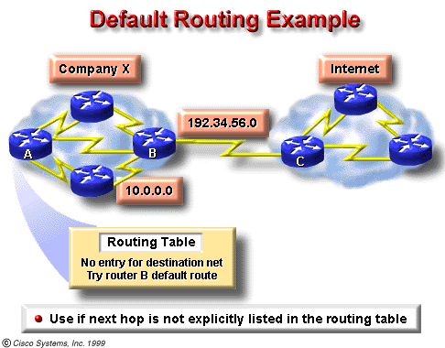
Define Default Route
Default routes keep routing tables shorter.
When an entry for a destination network does not exist in a routing table, the packet is sent to the default network.

Slide 45
Define Default Route(I)
Define a default route using dynamic routing protocols
Router(config)# ip default-network [network-number]
ip default network Command
Description
network-number
IP network number or subnet number defined as the default

Slide 46
Define Default Route(II)
Define a default route as a static route:
Router(config)# ip route 0.0.0.0 0.0.0.0 [next-hop-ip-address| exit-interface]
After configure a default route, use show ip route will display: (172.16.1.2 is the default next-hop address)
Gateway of last resort is 172.16.1.2 to network 0.0.0.0

Slide 47


谢 谢！

